Slide 1
Real Estate Price Prediction
106306029 資管四甲 羅恩力 En-Li, Luo

Slide 2
Outline
Web Crawler
Grey-Markov Model

Slide 3
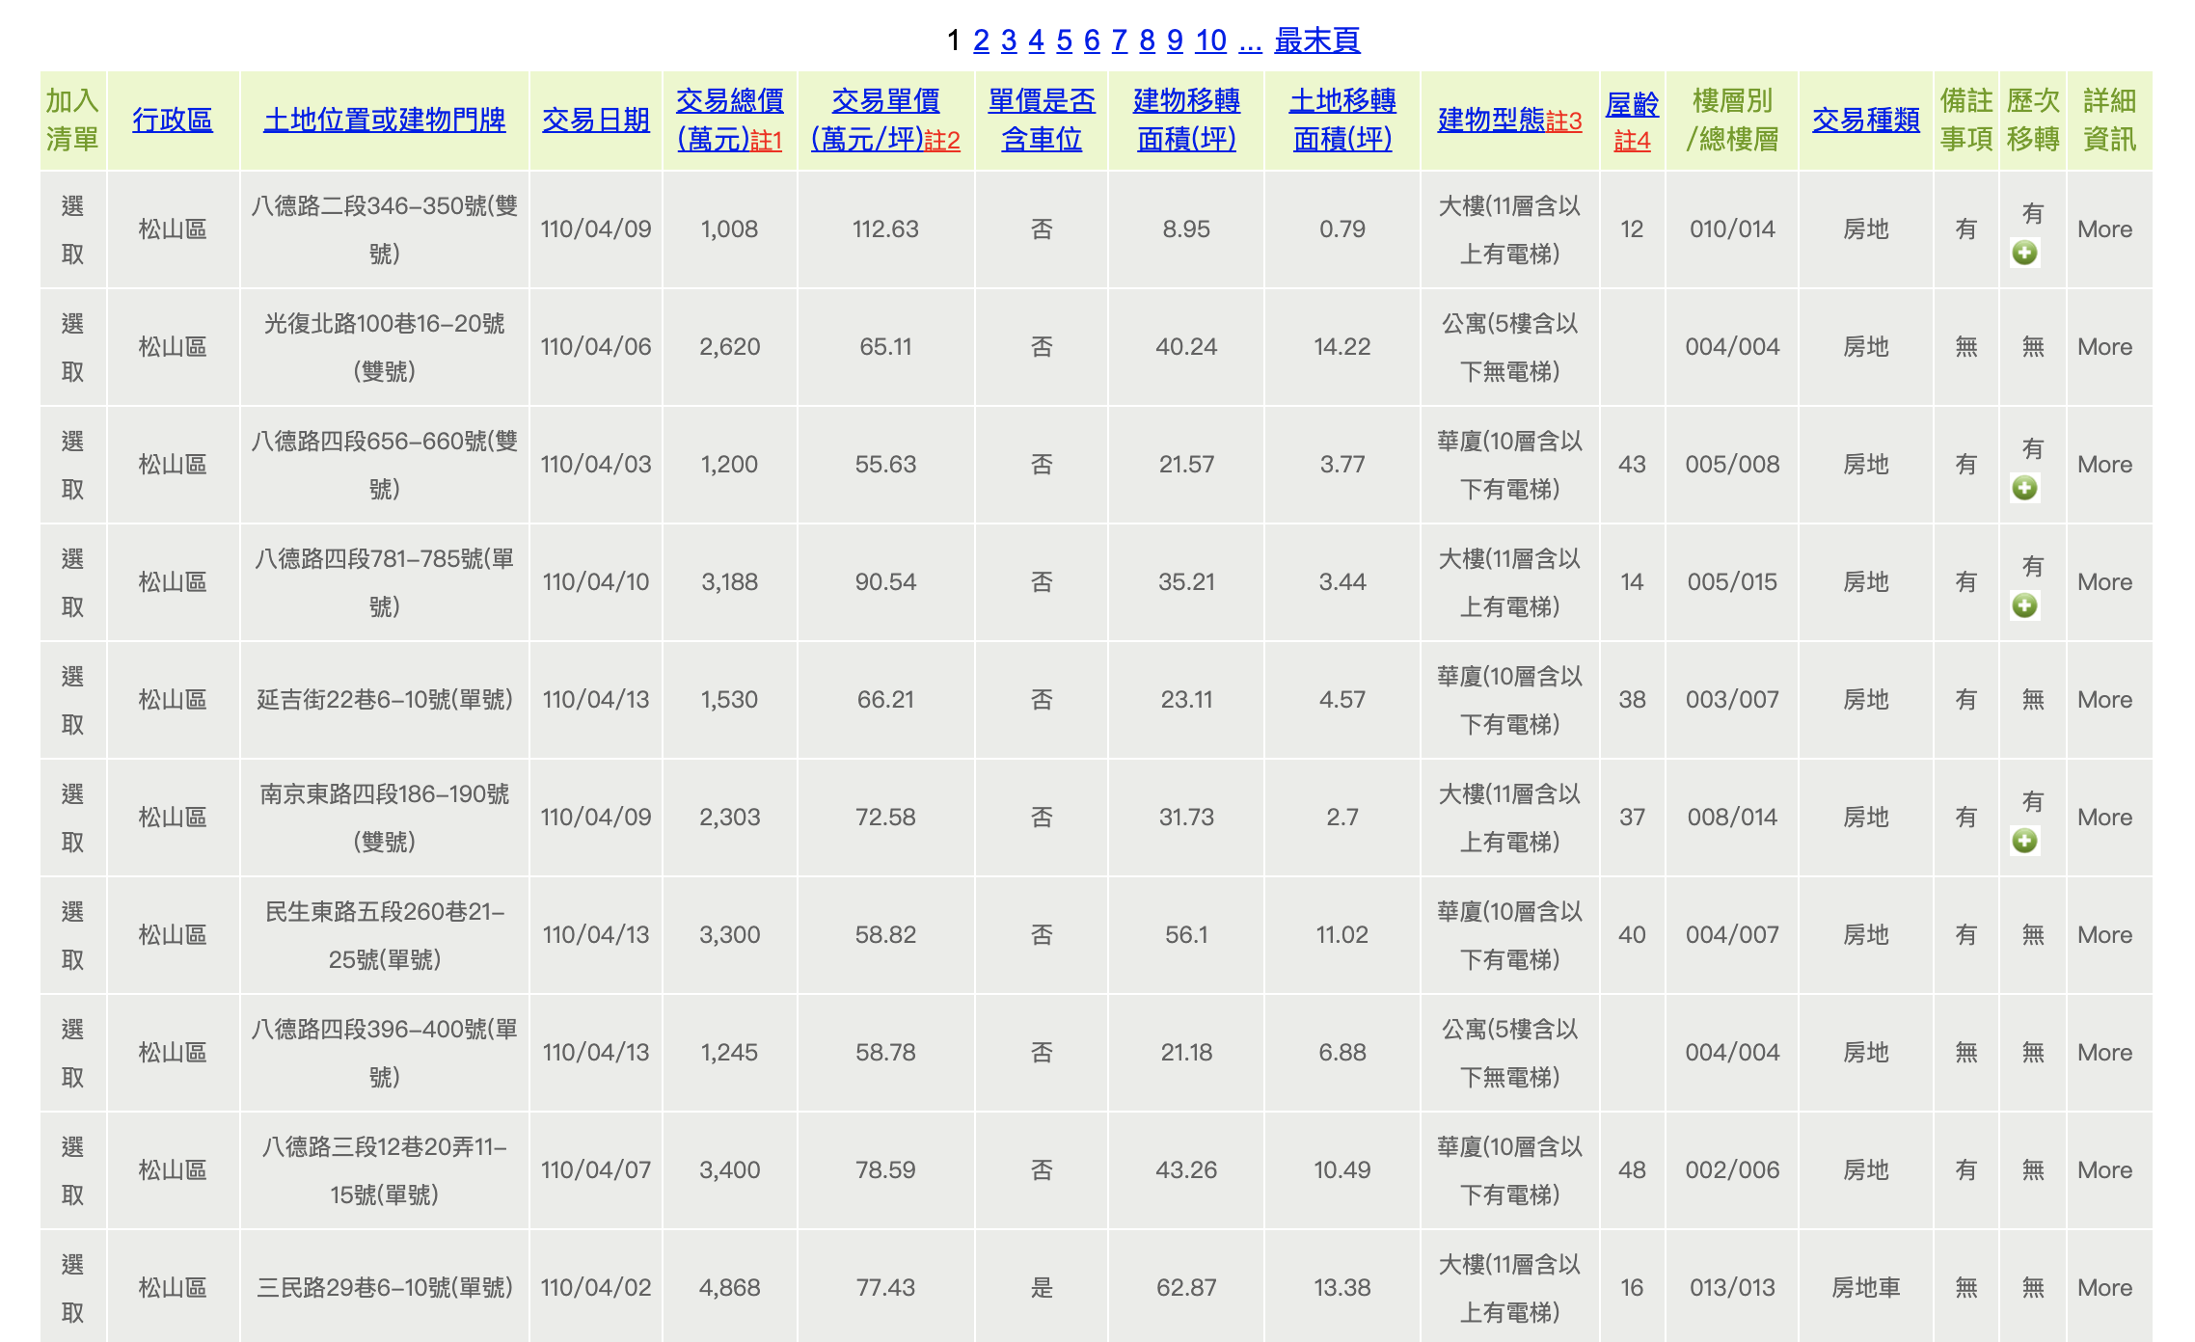
Open Government Data
https://cloud.land.gov.taipei/ImmPrice/TruePriceA.aspx

Slide 4
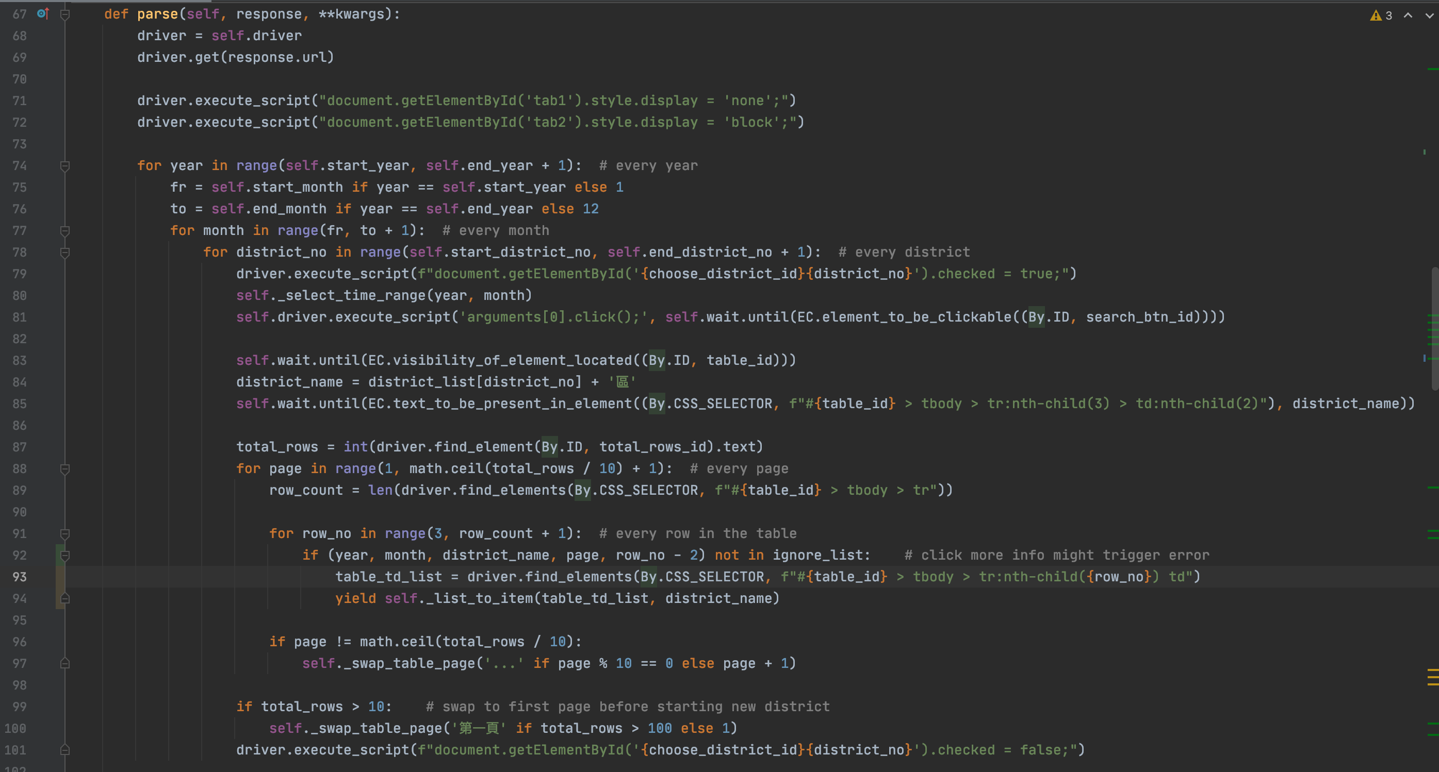
Scrapy

Slide 5
Selenium
click
https://cloud.land.gov.taipei/ImmPrice/TruePriceA.aspx

Slide 6
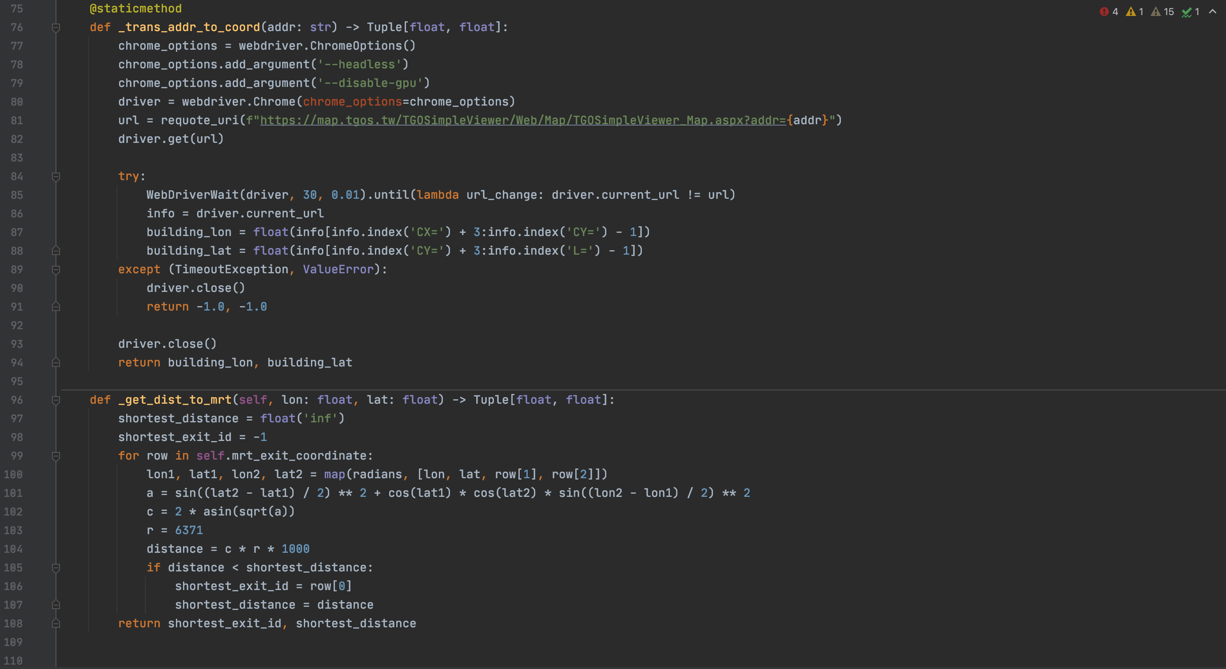
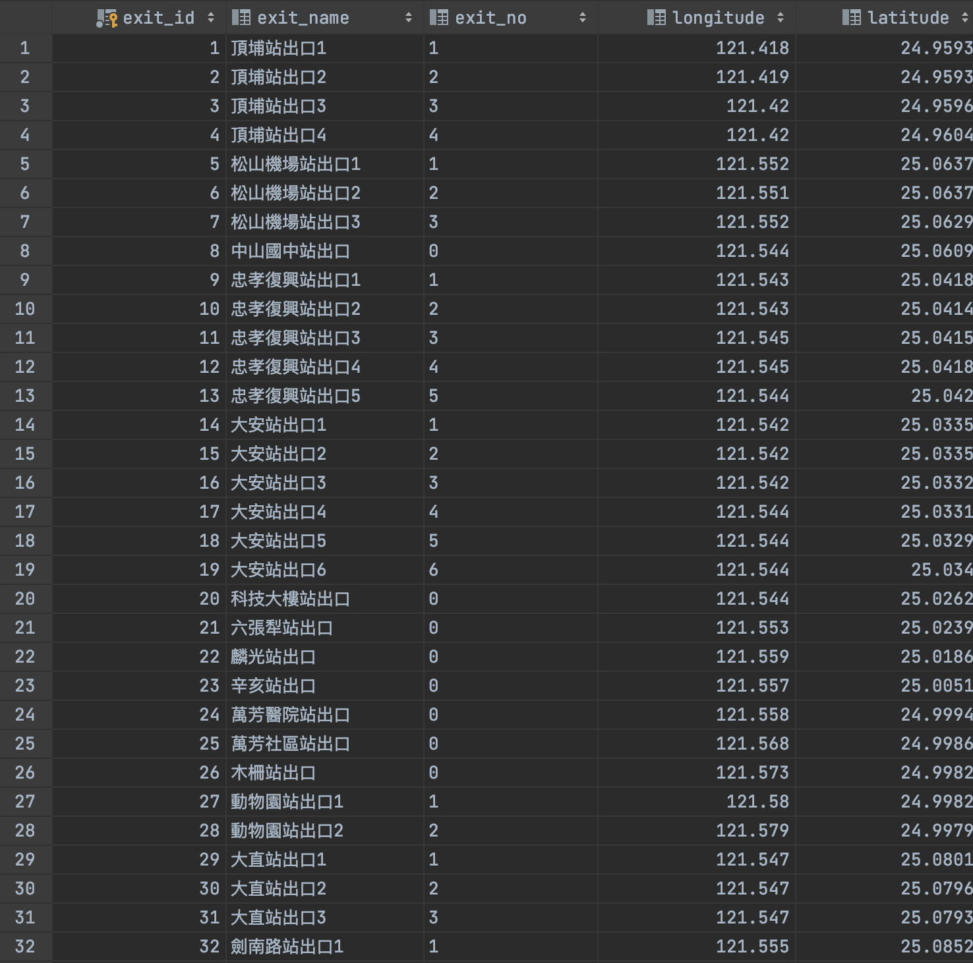
Distance to Nearest MRT Exit
data from Taipei MRT

Slide 7
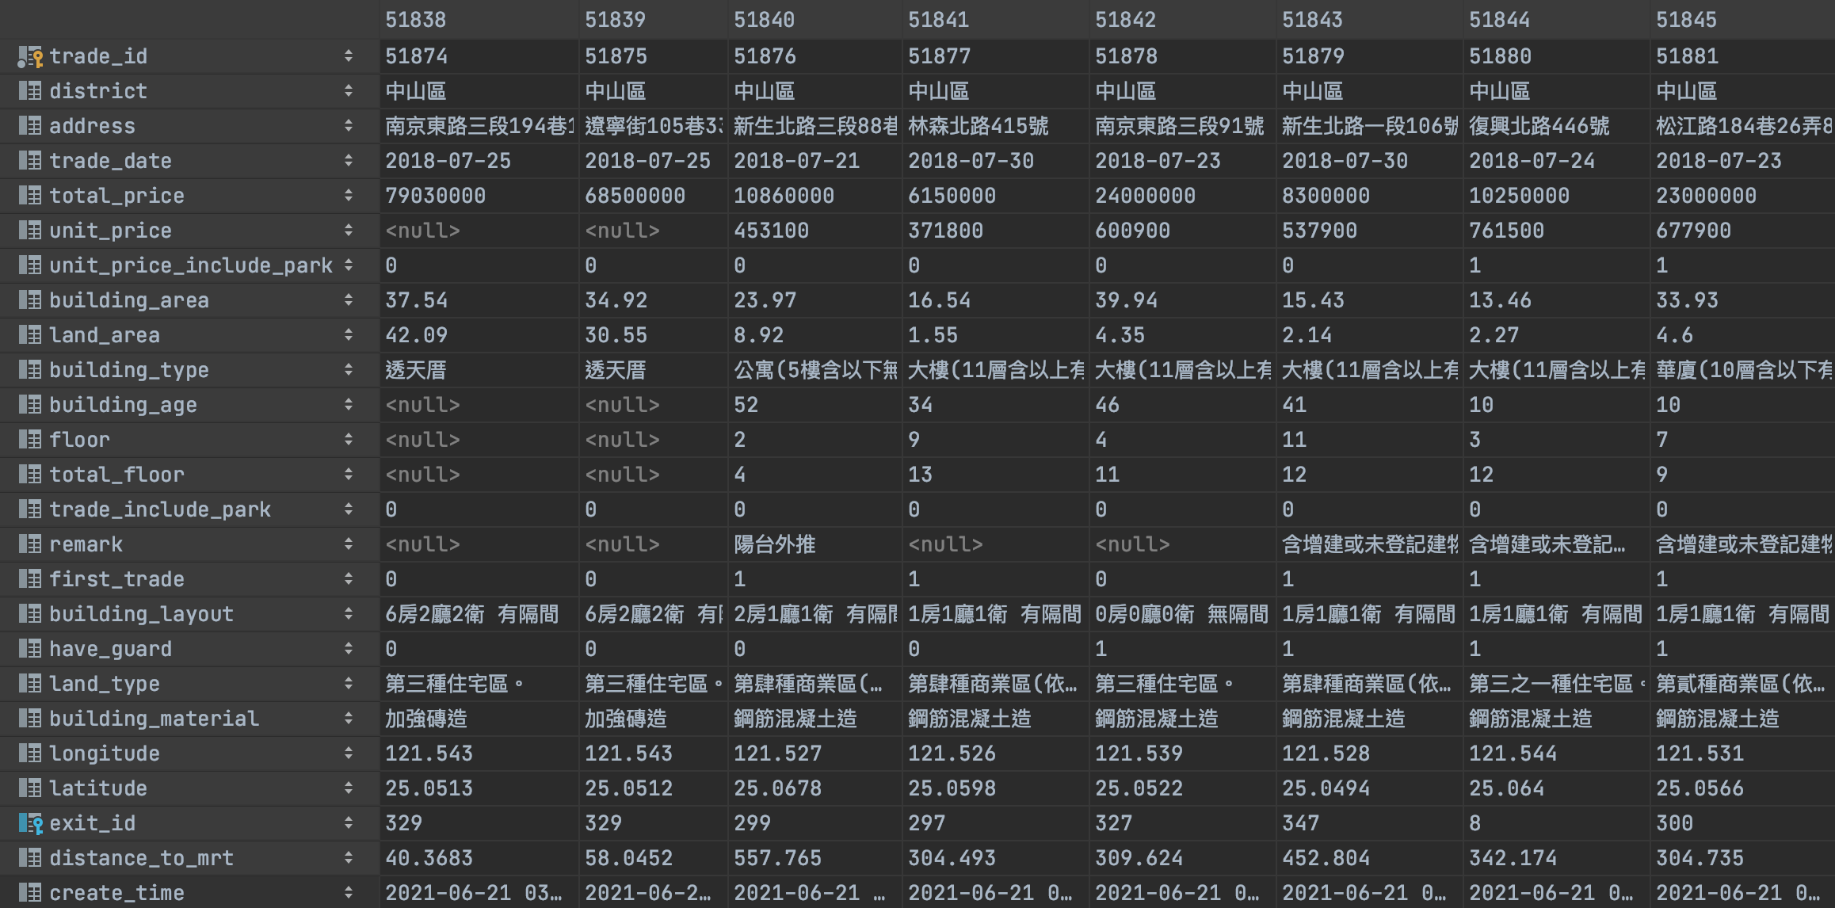
Data Preview
2018.01.01 – 2020.12.31
60368 rows

Slide 8
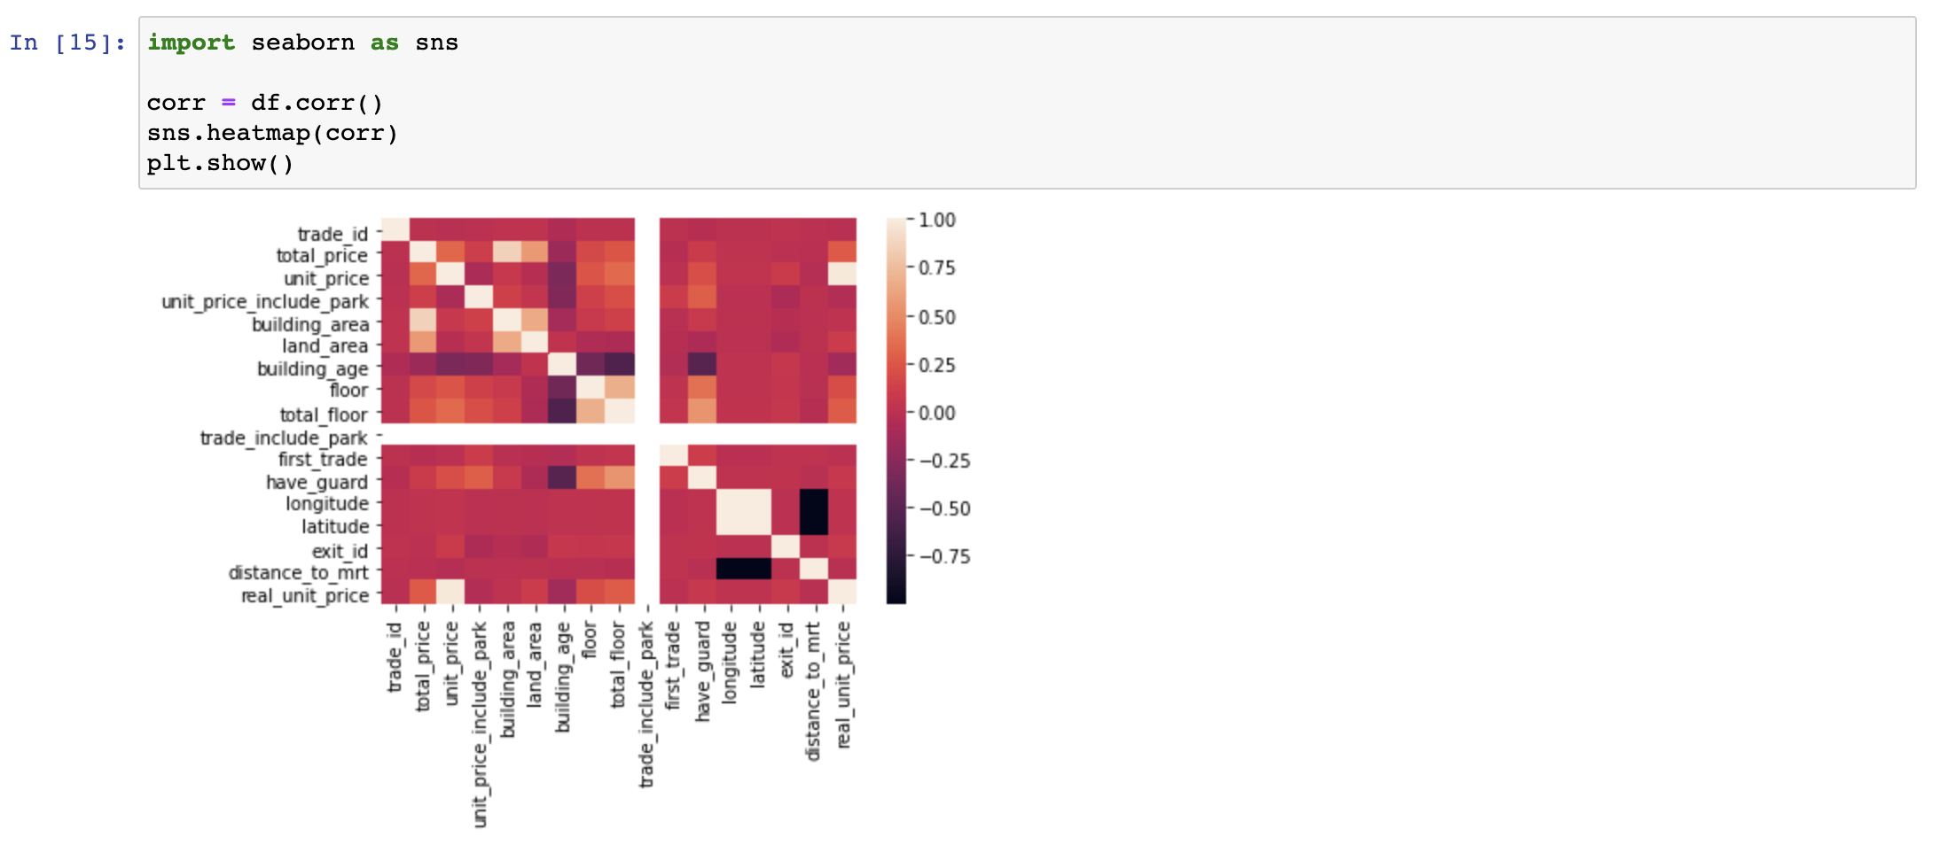
Data Preview

Slide 9
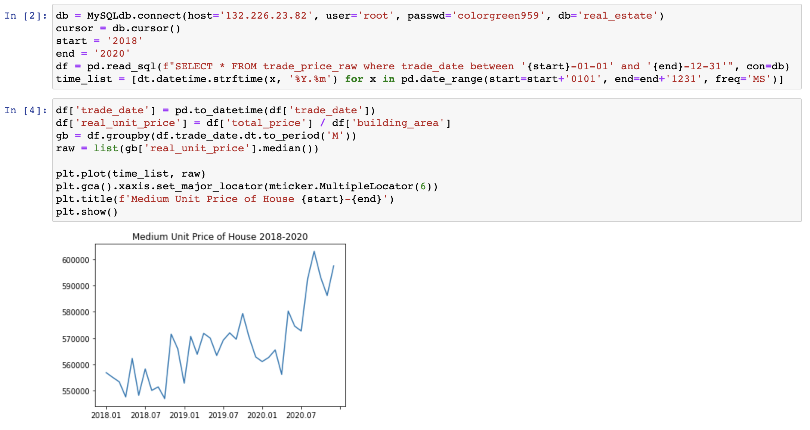
Medium Price for Every Month

Slide 10
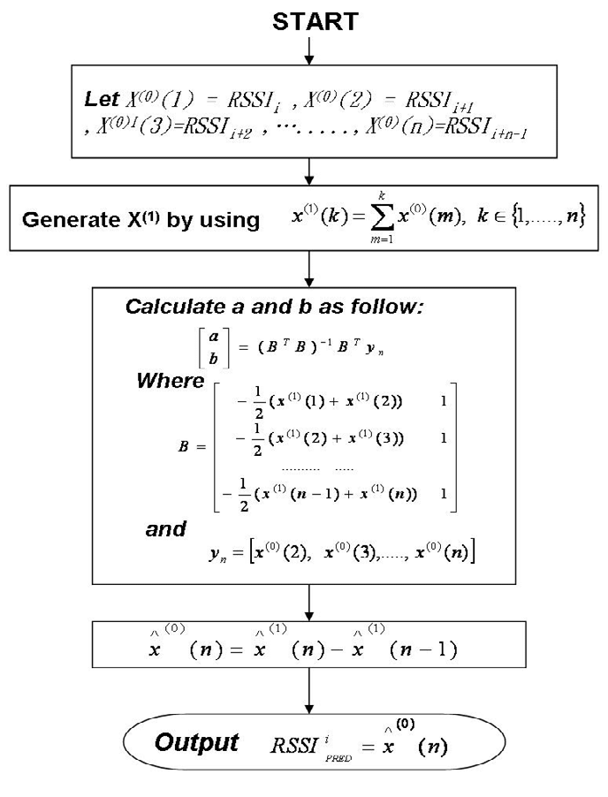
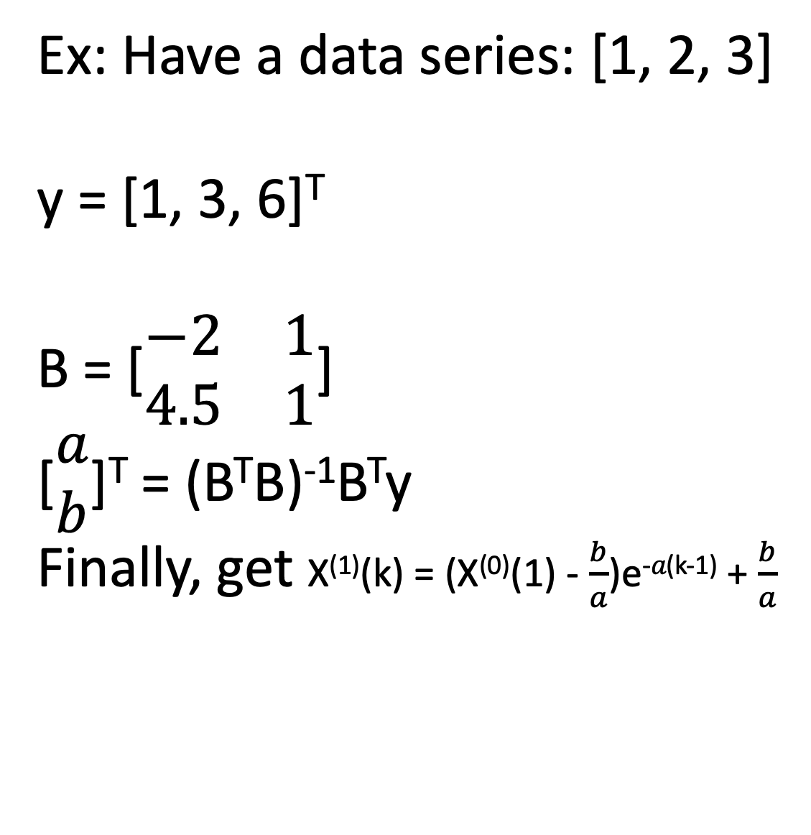

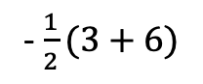
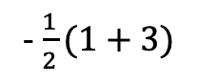
Grey Model(GM) for time series prediction
Ex: Have a data series: [1, 2, 3]
y = [1, 3, 6]^{T}
B = [$\begin{matrix}−2 & 1 \\ 4.5 & 1\end{matrix}$]
[$\begin{matrix}a \\ b\end{matrix}$]^{T} = (B^{T}B)⁻¹B^{T}y
Finally, get X⁽¹⁾(k) = (X⁽⁰⁾(1) - $\frac{b}{a}$)e^{-𝑎(k-1)} + $\frac{b}{a}$
-$\frac{1}{2}(1+3)$
-$\frac{1}{2}(3+6)$
$$a, b$$

Slide 11
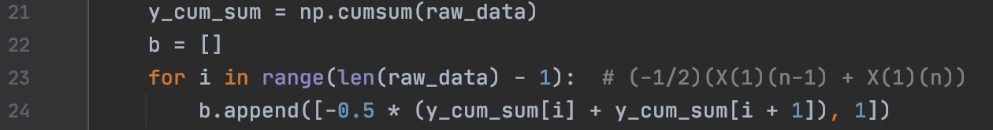
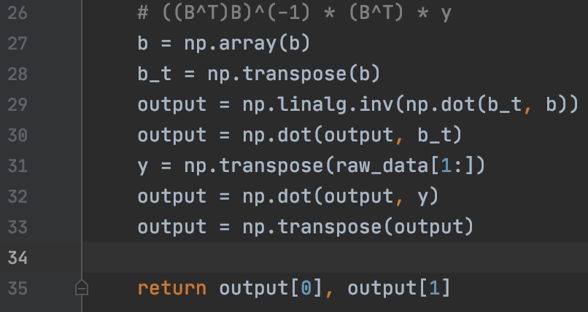
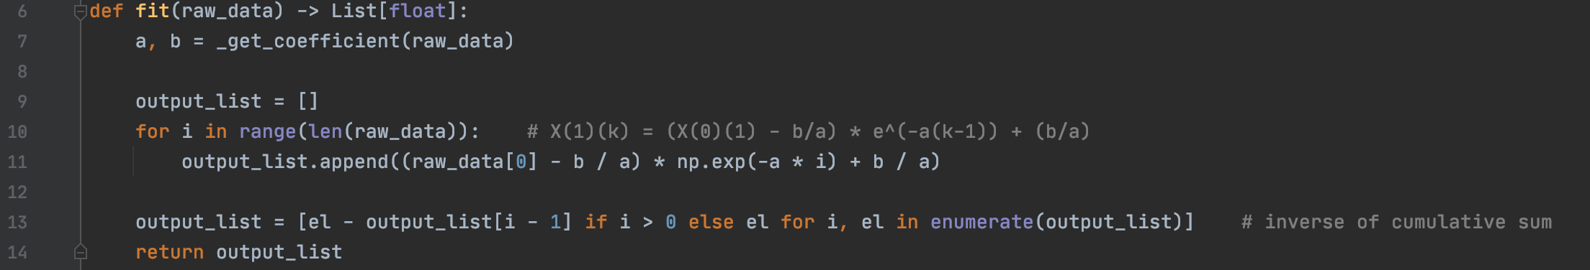
Grey Model(GM) for time series prediction
Ex: Have a data series: [1, 2, 3]
y = [1, 3, 6]^{T}
B = [$\begin{matrix}−2 & 1 \\ 4.5 & 1\end{matrix}$]
[$\begin{matrix}a \\ b\end{matrix}$]^{T} = (B^{T}B)⁻¹B^{T}y
Finally, get X⁽¹⁾(k) = (X⁽⁰⁾(1) - $\frac{b}{a}$)e^{-𝑎(k-1)} + $\frac{b}{a}$

Slide 12
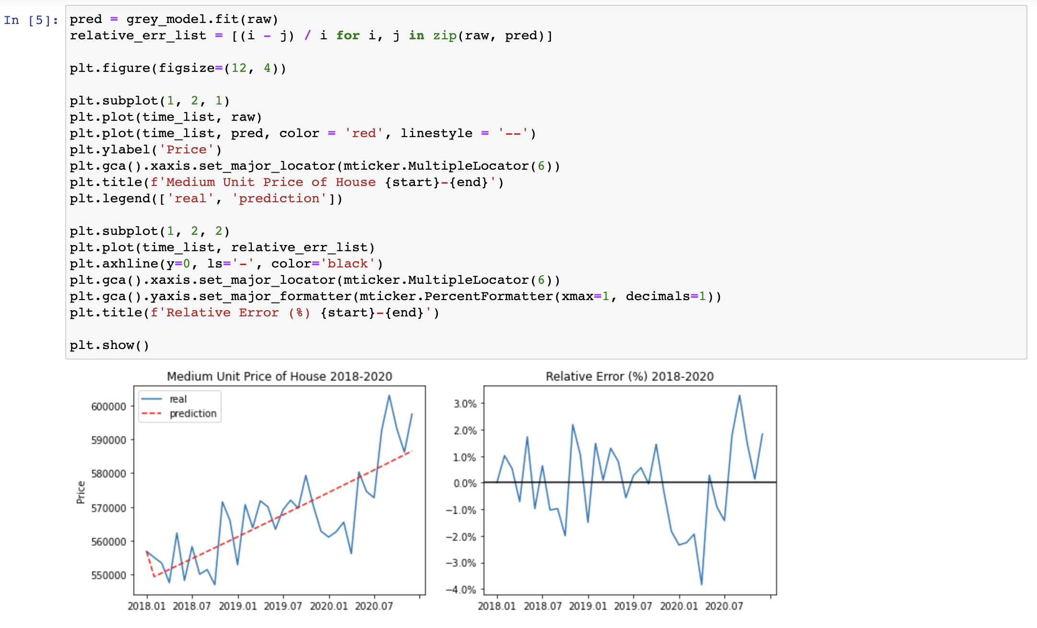
Grey Model(GM) for time series prediction

Slide 13
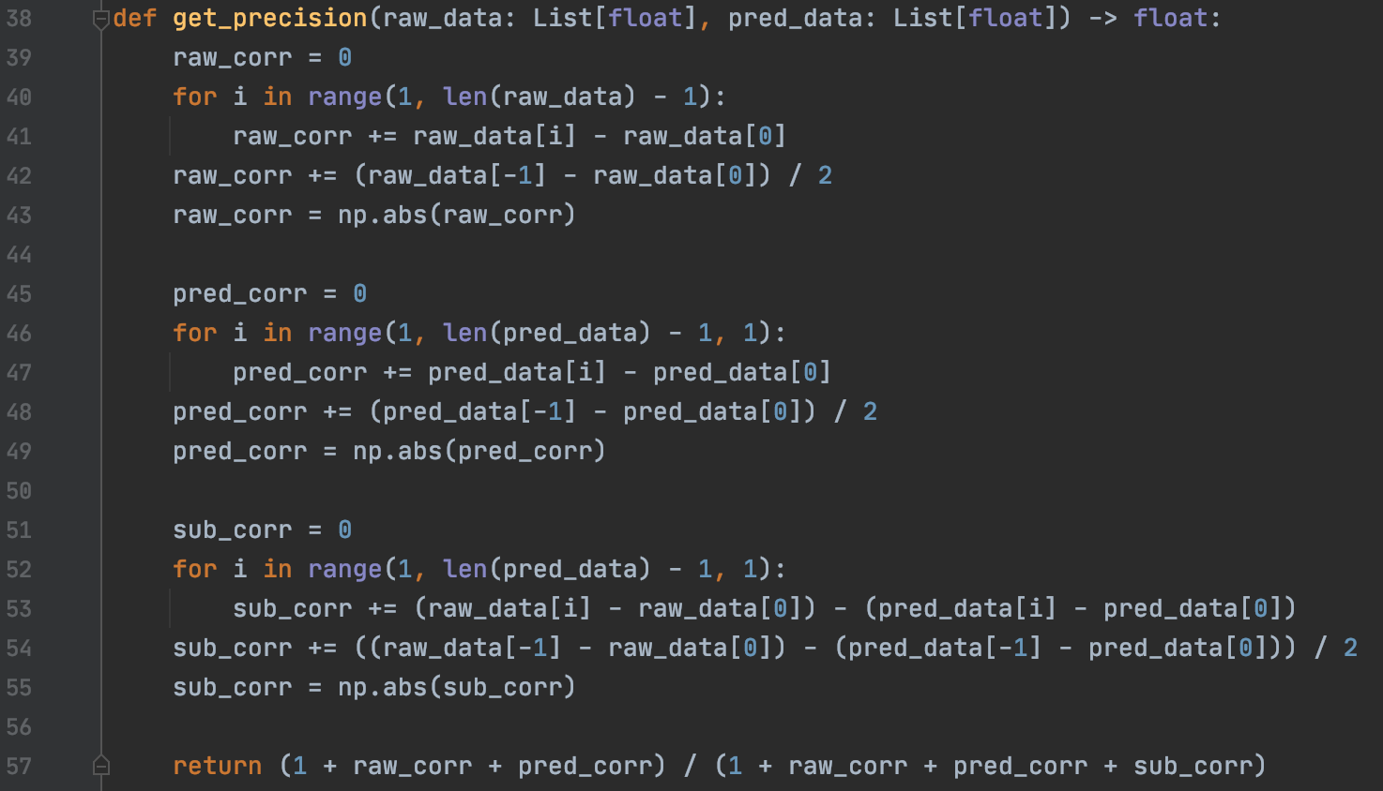
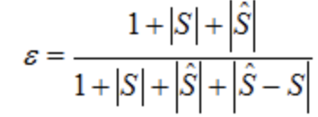
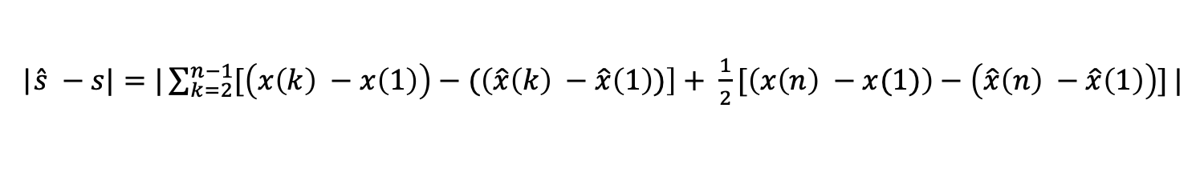
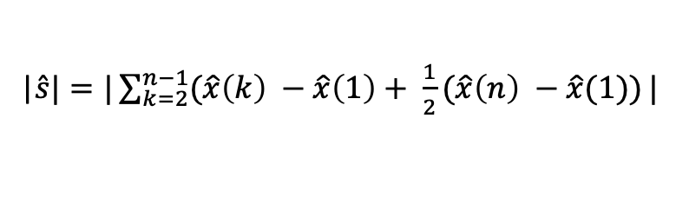

Validate My Grey Model(GM)
|$S|=|\sum_{k=2}^{n−1}{(x\left(k\right) −x\left(1\right)+ \frac{1}{2}(x\left(n\right) −x(1))}|$
|$\hat{s}|=|\sum_{k=2}^{n−1}{(\hat{x}\left(k\right) −\hat{x}\left(1\right)+ \frac{1}{2}(\hat{x}\left(n\right) −\hat{x}(1))}|$
|$\hat{s} −s|=|\sum_{k=2}^{n−1}{[\left(x\left(k\right) −x\left(1\right)\right)−(\left(\hat{x}\left(k\right) −\hat{x}\left(1\right))\right]+ \frac{1}{2}[\left(x\left(n\right) −x(1)\right)−\left(\hat{x}\left(n\right) −\hat{x}\left(1\right)\right)]}|$
1(best) | > 0.9
2 | > 0.8
3 | > 0.7
4 | > 0.6

Slide 14
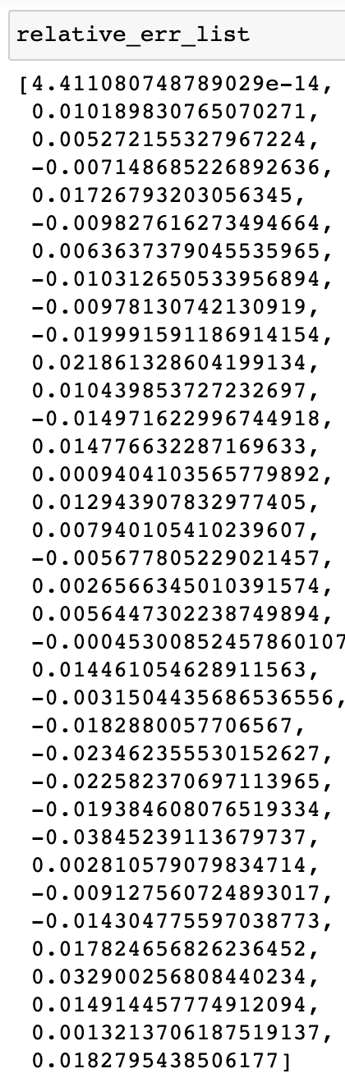
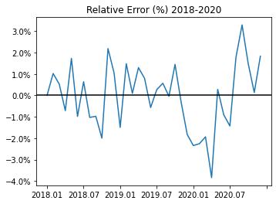
Markov Chain for Status Transform Prediction

Slide 15
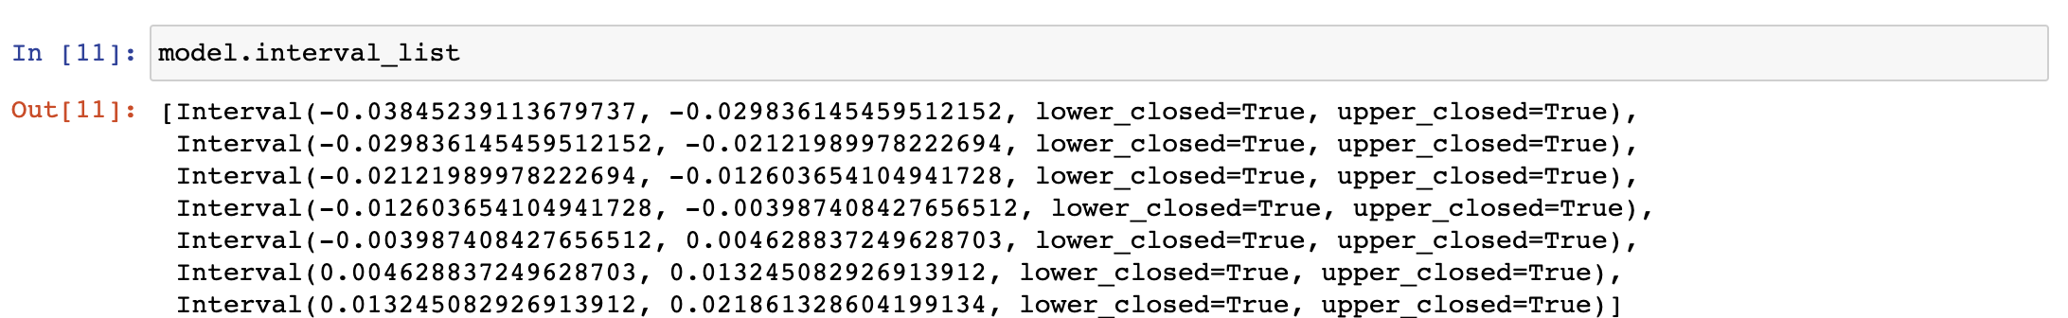
Markov Chain for Status Transform Prediction
Min: -3.85%
Max: 3.29%
Slice into 7 intervals:
Status1: -3.85% ~ -2.98%
Status2: -2.98% ~ -2.12%
Status3: -2.12% ~ -1.26%
Status4: -1.26% ~ -0.04%
Status5: -0.04% ~ 0.05%
Status6: 0.05% ~ 1.32%
Status7: 1.32% ~ 2.19%

Slide 16
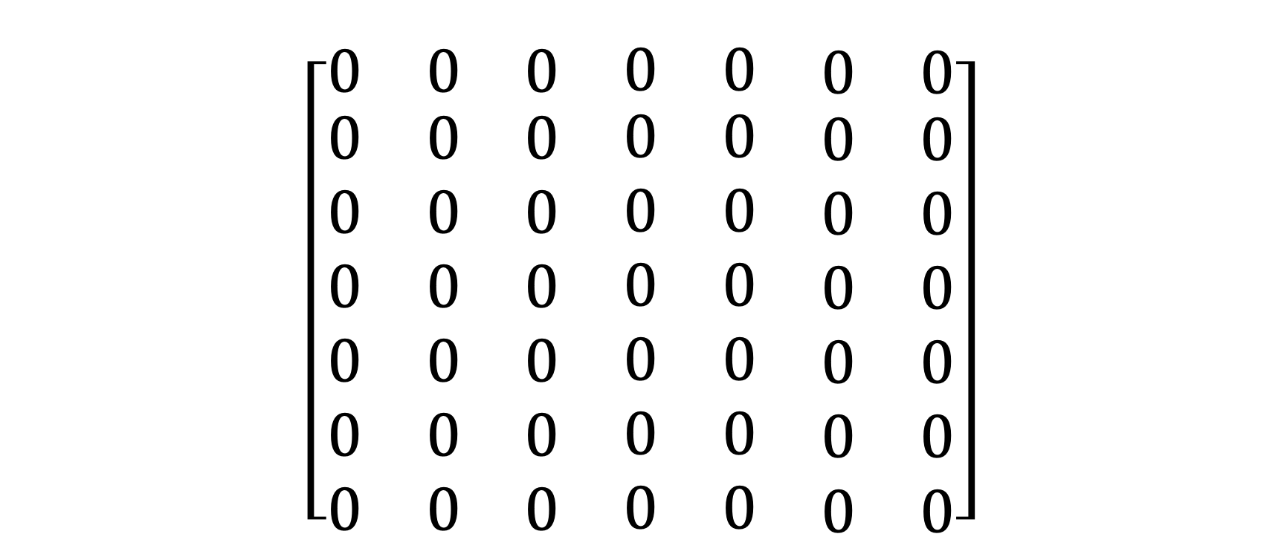
Markov Chain for Status Transform Prediction
Status1
Status2
Status3
Status4
Status5
Status6
Status7
$$\left[\begin{matrix}\begin{matrix}0 & 0 & 0\end{matrix} & \begin{matrix}0 & 0 & \begin{matrix}0 & 0\end{matrix}\end{matrix} \\ \begin{aligned}\begin{matrix}0 & 0 & 0\end{matrix} \\ \begin{matrix}0 & 0 & 0\end{matrix} \\ \begin{matrix}0 & 0 & 0\end{matrix} \\ \begin{matrix}0 & 0 & 0\end{matrix} \\ \begin{matrix}0 & 0 & 0\end{matrix} \\ \begin{matrix}0 & 0 & 0\end{matrix}\end{aligned} & \begin{aligned}\begin{matrix}0 & 0 & \begin{matrix}0 & 0\end{matrix}\end{matrix} \\ \begin{matrix}0 & 0 & \begin{matrix}0 & 0\end{matrix}\end{matrix} \\ \begin{matrix}0 & 0 & \begin{matrix}0 & 0\end{matrix}\end{matrix} \\ \begin{matrix}0 & 0 & \begin{matrix}0 & 0\end{matrix}\end{matrix} \\ \begin{matrix}0 & 0 & \begin{matrix}0 & 0\end{matrix}\end{matrix} \\ \begin{matrix}0 & 0 & \begin{matrix}0 & 0\end{matrix}\end{matrix}\end{aligned}\end{matrix}\right]$$
Status1
Status2
Status3
Status4
Status5
Status6
Status7

Slide 17
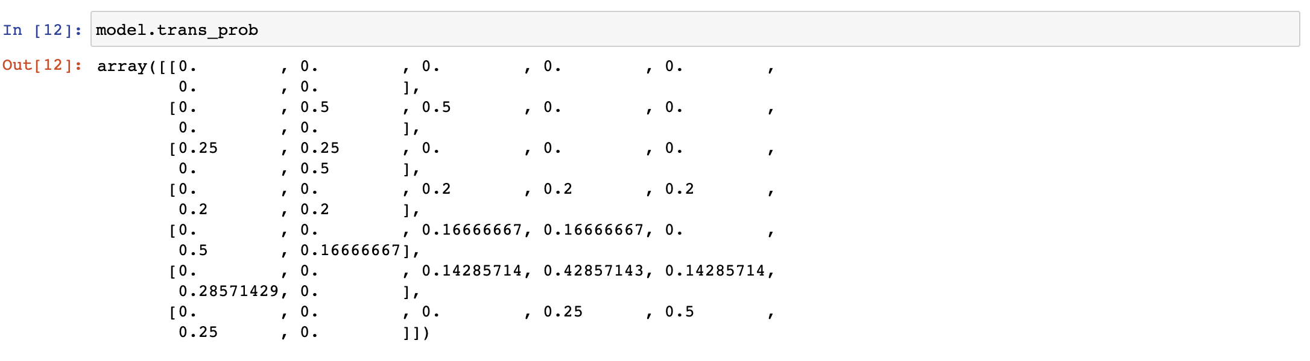
Markov Chain for Status Transform Prediction
Status6: vector = [0 0 0 0 0 1 0]
Status6 to Status7
Status7: vector = [0 0 0 0 0 0 1]
Status7 to …
Slice into 7 intervals:
Status1: -3.85% ~ -2.98%
Status2: -2.98% ~ -2.12%
Status3: -2.12% ~ -1.26%
Status4: -1.26% ~ -0.04%
Status5: -0.04% ~ 0.05%
Status6: 0.05% ~ 1.32%
Status7: 1.32% ~ 2.19%

Slide 18
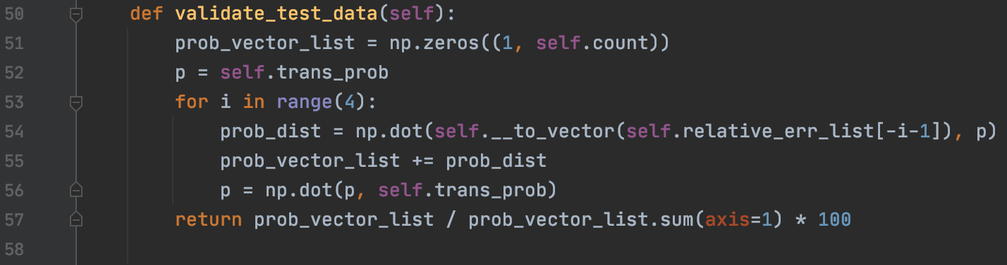
Markov Chain for Status Transform Prediction
2020.06 | [0 0 0 1 0 0 0] | 4 steps to 2020.10 | [0 0 0 1 0 0 0] * P⁽⁴⁾
2020.07 | [0 0 1 0 0 0 0] | 3 steps to 2020.10 | [0 0 1 0 0 0 0] * P⁽³⁾
2020.08 | [0 0 0 0 0 0 1] | 2 steps to 2020.10 | [0 0 0 0 0 0 1] * P⁽²⁾
2020.09 | [0 0 0 0 0 0 1] | 1 steps to 2020.10 | [0 0 0 0 0 0 1] * P⁽¹⁾
P =
Plus these 4 vector and calculate the most possible status.

Slide 19
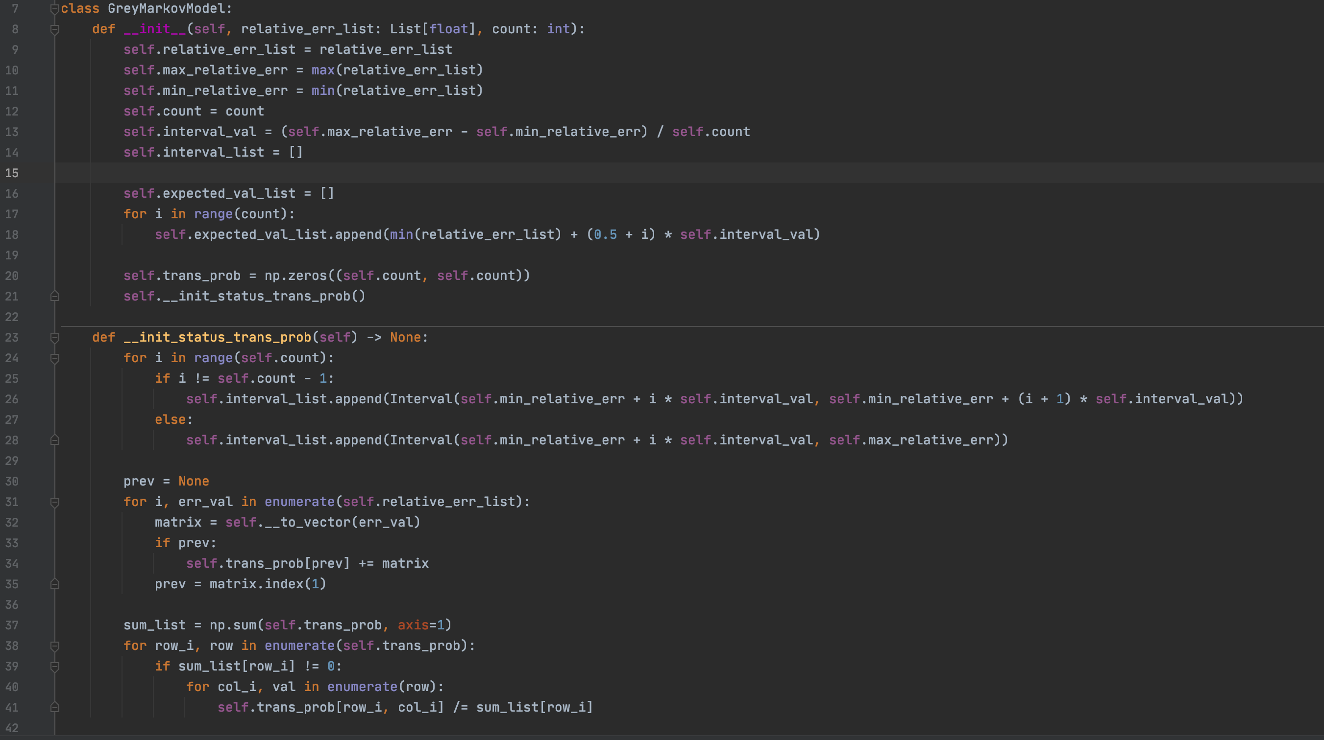
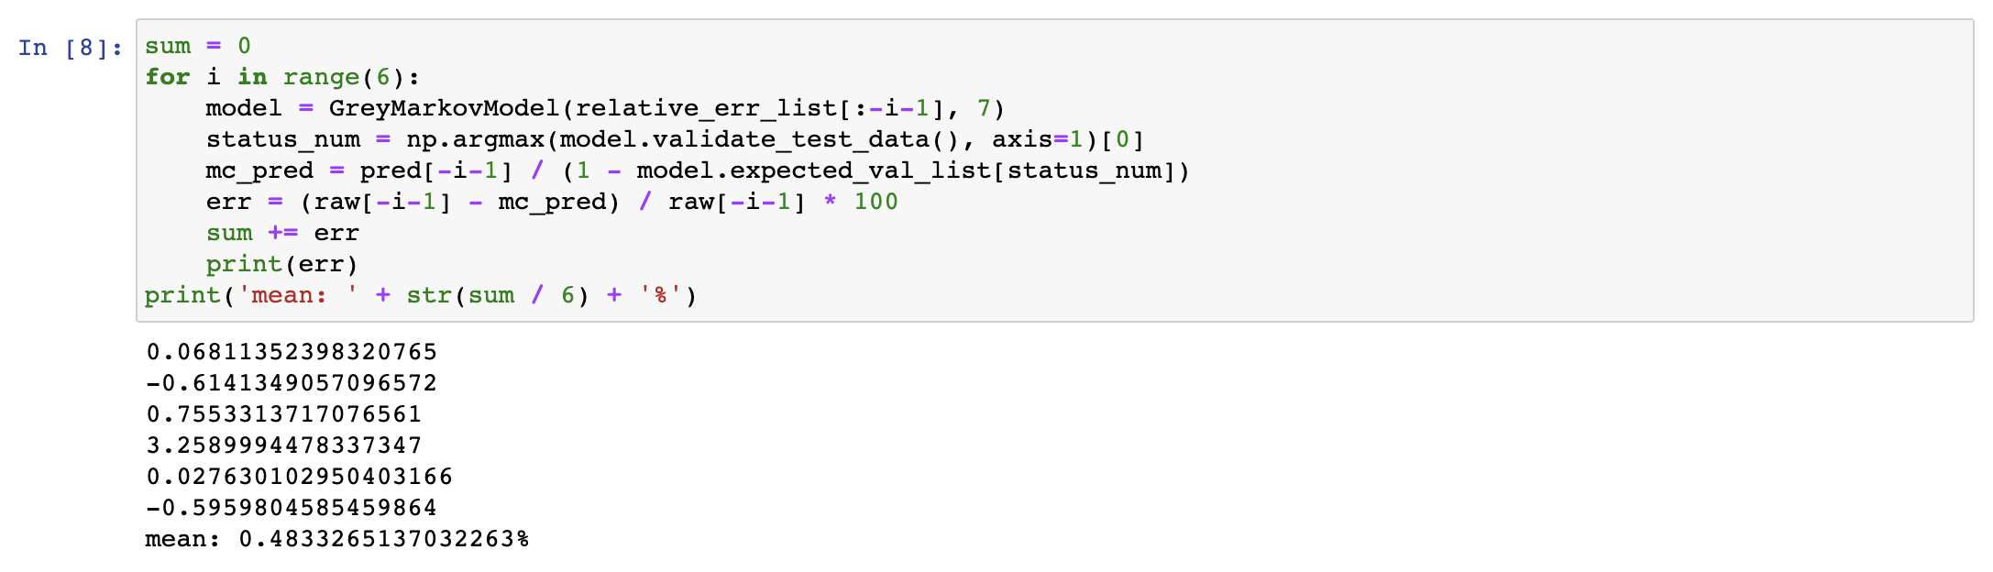
Markov Chain for Status Transform Prediction

Slide 20
Thank You

